Slide 1
Kotlin Basics
Info5126 :
Mobile Development Advanced

Slide 2
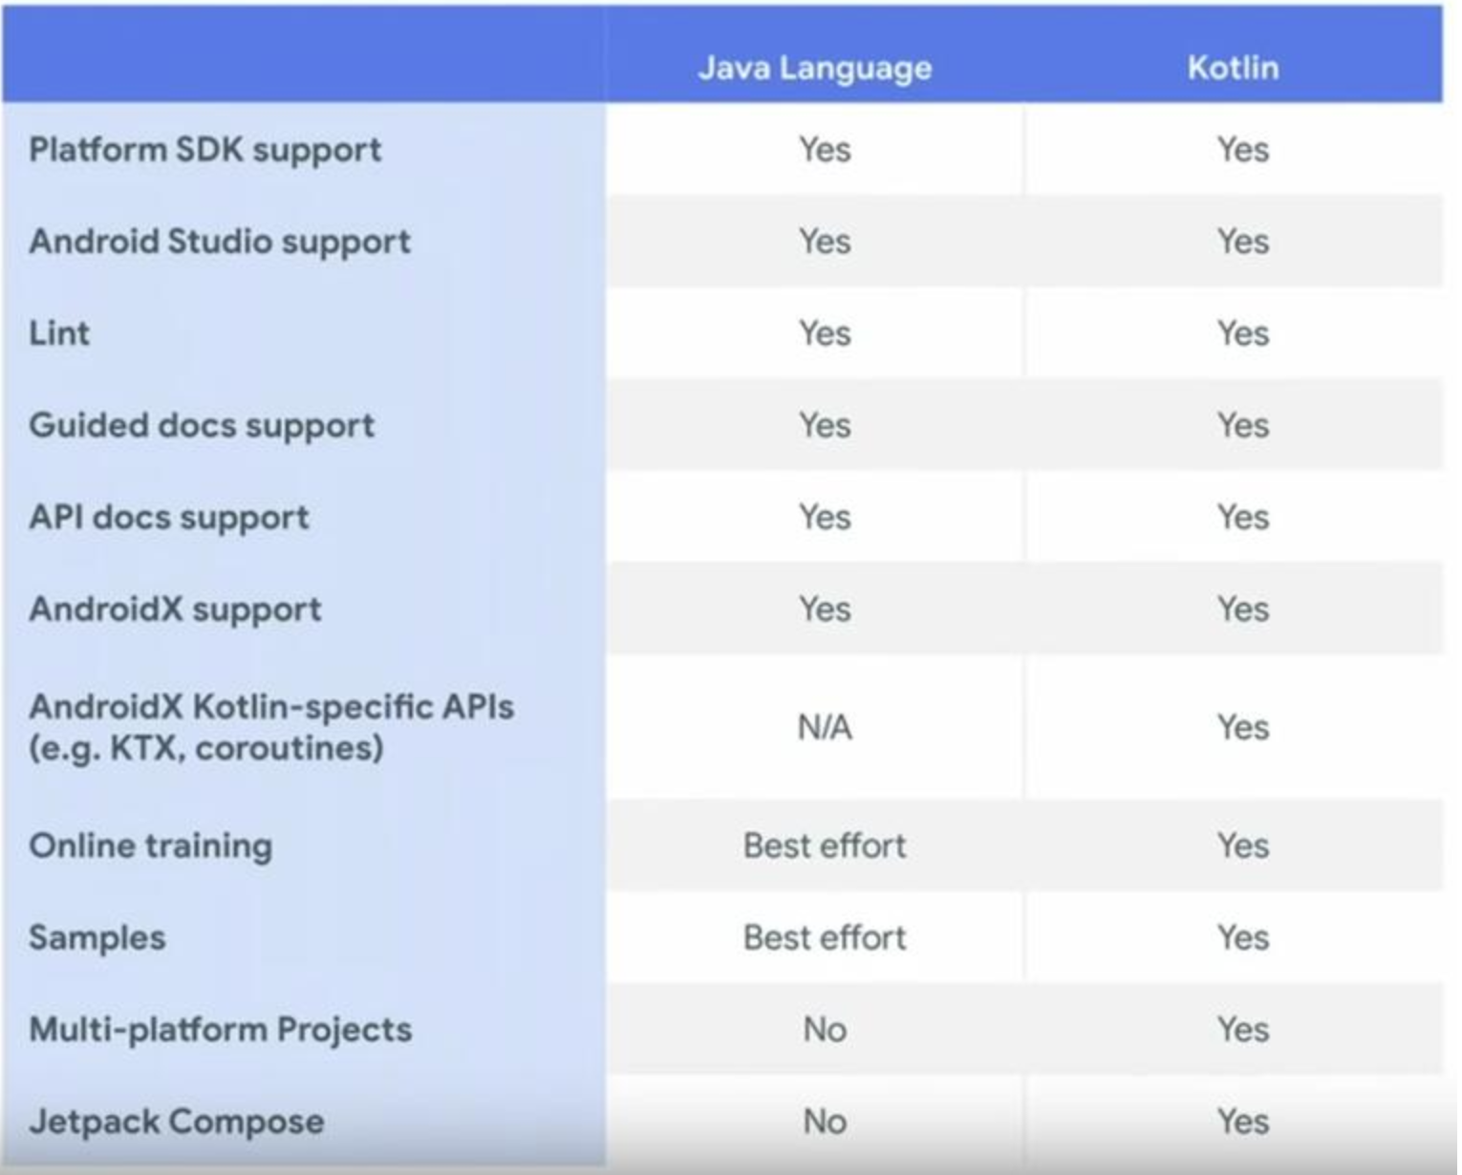
Java vs Kotlin

Slide 3
Kotlin Programming language
Developed by JetBrains
Programming language of choice for Android Development (May 7, 2019)
Mainly targets the JVM but also compiles to JavaScript or native code (via LLVM)
Fully interoperable with java code so the two languages can work in unison in the same project

Slide 4
Why Kotlin?
Concise: Drastically reduces the amount of boilerplate code
Safe: Avoid entire classes of errors such as null pointer exceptions (common mistake in Android development)
Interoperable: Leverage existing libraries for the JVM, Android and the browser
Tool-friendly: Can use any Java IDE or build from the command line (IntelliJ, Android Studio, Eclipse…)
No checked exceptions

Slide 5
Coding Kotlin
Main entry point is the main function
Semicolons are optional as a statement terminator, in most cases a newline is sufficient for the compiler to deduce that the statement has ended
Variables: use val for read only, use var for mutable

Slide 6
Kotlin variables and const
Variables: use val for read only or assign once, use var for mutable
Datatypes are inferred at declaration
var number = 42
number = 35
val name = “Lianne”
You can initialize and specify the type on the same line
val characters: CharSequence = “abc”
Constants are known at compile time, so can only declare them at the top level of a file or an object declaration, not a class declaration

Slide 7
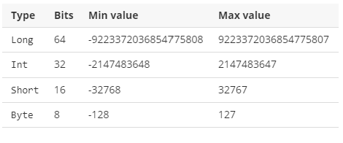
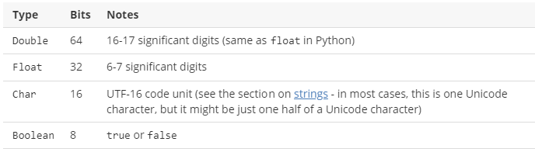
Kotlin datatypes
Integer types
Floating point types

Slide 8
Strings
Strings - UTF-16
ByteArray – UTF-8
String interpolation - use the $ and {} for expressions
val name = "Anne"
val yearOfBirth = 1985
val yearNow = 2018
val message = "$name is ${yearNow - yearOfBirth} years old“
val characters: CharSequence = “abc”

Slide 9
Conditionals
Checking if two variables refer to the same object use === and !==
Boolean logical expressions && and ||, while the Boolean bitwise expressions are and and or
Switch statements use when

Slide 10
Null safety ?
For null safety use ? to set variables as a nullable-type
var a: String = "abc" // Regular initialization means non-null by default
a = null // compilation error
var b: String? = "abc" // can be set null
b = null // ok
You can also use ? to make safe calls
println(b?.length) // safe call in case b is null
Note: the ? Can also work in chains bob?.department?.head?.name

Slide 11
Null safety
!! Operator – returns the non-null type value and throws an exception if the value is a null
val l = b!!.length
Elvis Operator (?:) – returns the expression to the left if not null and the expression to the right side if null
val l = b?.length ?: -1
Safe casting
val aInt: Int? = a as? Int
Collections of Nullable type use filterNotNull() to filter out the non-null elements
val nullableList: List<Int?> = listOf(1, 2, null, 4)
val intList: List<Int> = nullableList.filterNotNull()

Slide 12
Switch example
Java
public static double calculate (double a, String op, double b) throws Exception {
switch (op) {
case "add":
return a + b;
case "subtract":
return a - b;
case "multiply":
return a * b;
case "divide":
return a / b;
default:
throw new Exception();
}
}
Kotlin
fun calculate (a: Double, op: String, b: Double): Double {
when (op) {
"add" -> return a + b
"subtract" -> return a - b
"multiply" -> return a * b
"divide" - > return a / b
else -> throw Exception()
}
}

Slide 13
Collections
Immutable
val strings = listOf("Anne", "Karen", "Peter") // List<String>
val map = mapOf("a" to 1, "b" to 2, "c" to 3) // Map<String, Int>
val set = setOf("a", "b", "c") // Set<String>
Mutable
val strings = mutableListOf("Anne", "Karen", "Peter")
val map = mutableMapOf("a" to 1, "b" to 2, "c" to 3)
val set = mutableSetOf("a", "b", "c")
Empty
val noInts: List<Int> = listOf()
val noStrings = listOf<String>()
val emptyMap = mapOf<String, Int>()

Slide 14
Loops
val names = listOf("Anne", "Peter", "Jeff")
for (name in names) {
println(name)
}
for (x in 0..10) println(x) // Prints 0 through 10 (inclusive)
for (x in 0 until 10) println(x) // Prints 0 through 9
for (x in 0 until 10 step 2) println(x) // Prints 0, 2, 4, 6, 8
for (x in 10 downTo 0 step 2) println(x) // Prints 10, 8, 6, 4, 2, 0
val numbers = (0..9).toList()
for ((index, value) in names.withIndex()) {
println("$index: $value") // gives index of current element
}
// Iterate over the entries as objects that contain the key and the value as properties
for (entry in map) {
println("${entry.key}: ${entry.value}")
}
// Iterate over the entries as separate key and value objects
for ((key, value) in map) {
println("$key: $value")
}
// Iterate over the keys
for (key in map.keys) {
println(key)
}
// Iterate over the values
for (value in map.values) {
println(value)
}

Slide 15
Kotlin functions
Declare using the fun keyword
Class member functions are virutal
Class members are public by default
Classes are final by default
To derive a class declare it with the open keyword

Slide 16
Kotlin functions 2
fun happyBirthday(name: String, age: Int): String {
return "Happy ${age}th birthday, $name!"
}
fun square(number: Int) = number * number

Slide 17
Classes
Class members are public by default
Classes are final by default
To derive a class declare it with the open keyword
Inherited built in functions: toString(), equals(x), hashCode()
If a member is not initialized during construction use lateinit
Overload operators (ie operator +)
Operator fun plus( spouse : Person )

Slide 18
Objects and Companion Objects
object keyword alone generates a Singleton (only one instance). The instance is created first time it is accessed in a thread-safe manner
companion objects are functions or properties that are tied to a class rather than instances of it. It is a singleton and its members can be accessed directly via the name of the containing class. Like a static method

Slide 19
Java to Kotlin
Most times if you copy Java code and paste it into a Kotlin window, the IDE will recognize the Java code and ask you if you would like to convert it to Kotlin. I found this useful when learning Kotlin or changing your existing code into Kotlin

